Slide 1

Making Simon says
Tales of my first independent web game

Slide 2
Gameplay
Simon says is a memory game that creates a new melody every time we play it, and challenges us to memorize it. Every time we succeed, the melody becomes longer.
The colors and sounds that are assigned to each button, help us remember the order of the melody’s sequence.
Once we make a mistake, the game restarts. I added a high score feature so as to challenge the user.
There’s usually a welcoming dance of colors when the game starts, which I made sure to include.

Slide 3
Building with classes
I was influenced by one of our instructors, Paris, to build a game using class oriented programming for the card game. I believed it would provide for an interesting and fruitful challenge.
Classes are models for creating objects. Getting a handle on their syntax and usage wasn’t very hard, especially when looking at Paris’ code and using it as a learning tool.
An unexpected challenge arose from Javscript’s inherent features. Namely, event-driven flow and being asynchronic. In simpler terms, it was hard to get the lights to shine in the correct sequence.
The solution was to be a combination of the “setTimeout” function, and some math. More details on the next page.

Slide 4
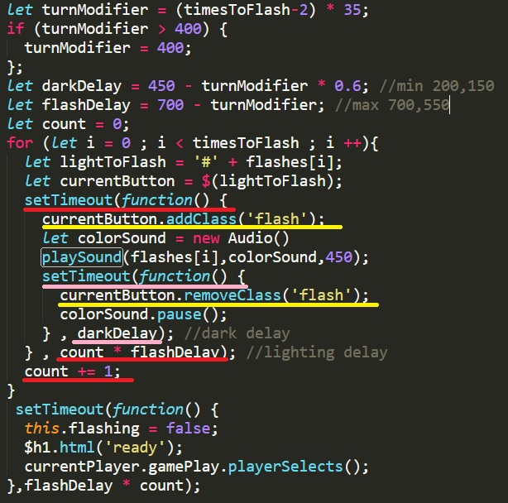

Slide 5
Things I learned
I was able to do more than I expected. I’d like to make more games.
Reading the Airbnb and Google guides taught me a lot about how to utilize ES6 and format my code. I’ll still want to proof future projects, but I feel like some new habits will stick.
Timing in JavaScript is not straightforward
But working with sound was.

Slide 6


